Slide 1
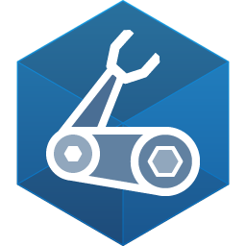
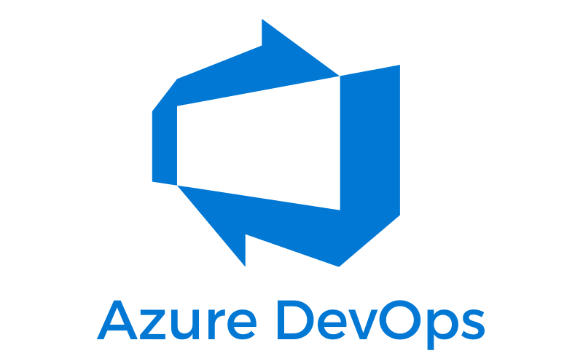
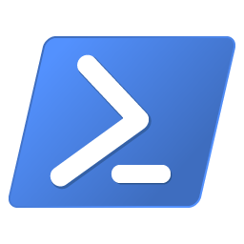
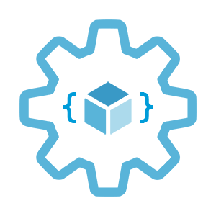

Automate
workload provisioning with Azure DevOps
Infrastructure as Code User Group Oslo
25.01.2023
with Evgeny Borzenin

Slide 2


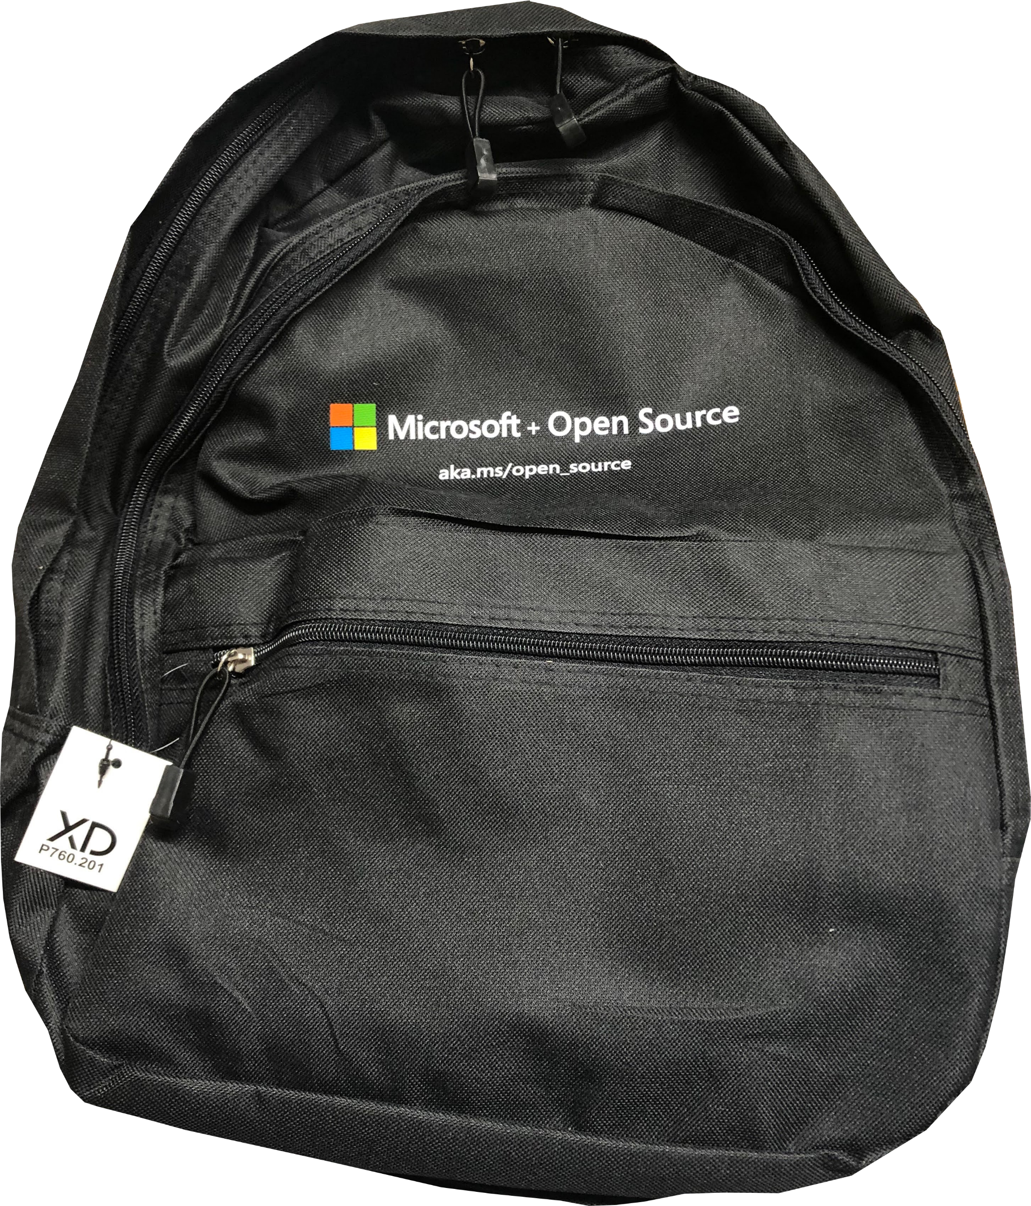

Deploy resources with Bicep and Azure PowerShell
aka.ms/learn-iac
We give away a cool Microsoft Azure backpack for today’s best technical question
Add Microsoft Azure skill to your LinkedIn account
+ Microsoft Azure
Notes:
Our usergroup partners with Microsoft Norway
On this slide you’ll find a link to the documentation about IaC.

Slide 3
Infrastructure as Code User Group roadmap
AKS workshops roadmap:
[x] 2021-2022 - AKS workshops 6 out of 8
[ ] Automate workload provisioning with Azure DevOps
[ ] Azure Networking 101
[ ] Azure Networking Hub-and-Spoke
[ ] Azure API Management 101
[ ] Azure Landing Zones with Bicep 101 (Not 100% decided yet)
[ ] Security in AKS
“regular” events - very unlikely ☺, but ping me if you have interesting topic to present

Slide 4
Workshops in your organization
Infrastructure as Code (Bicep, ARM, Automation with Azure DevOps and GitHub Actions)
AKS workshops
Workshops can be adapted for your organization use-case
List of past workshops: https://borzenin.com/workshops/
Commercial offer from Enso AS
Contact me at evgeny@enso.no if any interest

Slide 5



Microsoft Teams 101
Mute your mic (but don’t forget to unmute when you speak)
Feel free to use video
«Rise your hand» if you need some attention
Conversation/chat
Share screen

Slide 6

Practical information
When you done working with lab, post to the Conversation channel
lab-01 (lab-02, lab-03 etc…)
Feel free to contribute to the labs content by fixing gramma, typos, wrong commands etc..
Feel free to left your comments on workshop main page

Slide 7
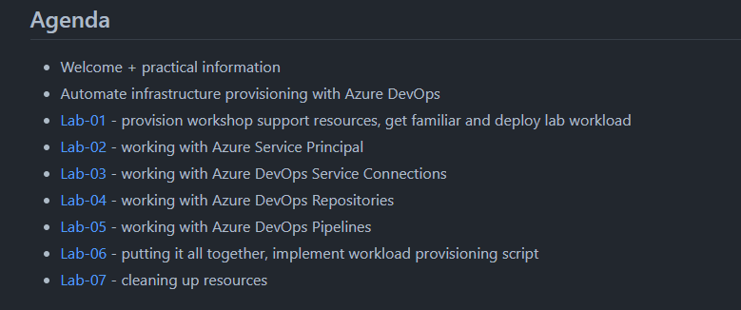
Agenda

Slide 8
Automate
workload provisioning with Azure DevOps

Slide 9
What is Workload?
Collection of IT assets
Infra - VMs, Web Apps, Azure Functions, AKS, Database
Apps – WebApps, APIs, BatchExecutors, etc…
Data
Supports well defined business capability
Can depend on other shared assets and other workloads
Has individual BCDR, CIA, SLA characteristics
Has an owner - both business (PO) and technical (IT)
Notes:
What is workload?
A workload is a collection of IT assets (VMs, applications, data etc…) that collectively support a defined process.
Workload can also depend on other shared assets.
A workload should have defined boundaries regarding the dependent assets and the processes that depend upon the workload.

Slide 10
Workload Provisioning
Environment
provisioning
Infrastructure deployment
Application(s) deployment
Data deployment
Notes:
Repeatable Infrastructure
Historically, deploying a new service or application involves manual work such as procuring and preparing hardware, configuring operating environments, and enabling monitoring solutions. Ideally, an organization would have multiple environments in which to test deployments. These test environments should be similar enough to production that deployment and run time issues are detected before deployment to production. This manual work takes time, is error-prone, and can produce inconsistencies between the environments if not done well.
Cloud computing changes the way we procure infrastructure. No longer are we unboxing, racking, and cabling physical infrastructure. We have internet accessible management portals and REST interfaces to help us. We can now provision virtual machines, databases, and other cloud services on demand and globally. When we no longer need cloud services, they can be easily deleted.
However, cloud computing alone does not remove the effort and risk in provisioning infrastructure. When using a cloud portal to build systems, many of the same manual configuration tasks remain. Application servers require configuration, databases need networking, and firewalls need firewalling.
To fully realize deployment optimization, reduce configuration effort, and automate full environments' deployment, something more is required. One option is referred to as infrastructure as code.
Infrastructure as code (IaC) is the management of infrastructure - such as virtual machines, load balancers, and connection topology - in a descriptive model, using a versioning system that is similar to what is used for source code. When you're creating an application, the same source code will generate the same binary every time it is compiled. In a similar manner, an IaC model generates the same environment every time it is applied. IaC is a key DevOps practice, and it is often used with continuous delivery.
Ultimately, IaC allows you and your team to develop and release changes faster, but with much higher confidence in your deployments.

Slide 11
IaC - confidence
Integrate with your process
Consistency
Automated scanning
Secret management
Access control
Avoid configuration drift
Notes:
Integrate with your process. If you have a process by which code changes are peer reviewed, you can use that same process for reviewing infrastructure changes. This review process can help proactively detect problematic configurations that are difficult to detect when making manual infrastructure changes.
Consistency. Following an IaC process ensures that the whole team follows a standard, well-established process. Historically, some organizations designate a single or small set of individuals responsible for deploying and configuring infrastructure. By following a fully automated process, responsibility for infrastructure deployments moves from individuals into the automation process and tooling. This move broadens the number of team members who can initiate infrastructure deployments while maintaining consistency and quality.
Automated scanning. Many types of IaC configurations can be scanned by automated tooling. One such type of tooling is linting to check for errors in the code. Another type will scan the proposed changes to your Azure infrastructure to ensure they follow security and performance best practices. This can be an important part of a Continuous Security approach.
Secret management. Most solutions require secrets to be maintained and managed. These include connection strings, API keys, client secrets, and certificates. Following an IaC approach means that you need to adopt best practices for managing secrets. For example, Azure Key Vault is used to store secrets securely. It integrates with many IaC tools and configurations to ensure that the person conducting the deployment doesn't need access to production secrets. This in turn helps you adhere to the security principle of least privilege.
Access control. A fully automated IaC deployment pipeline means that an automated process should perform all changes to your infrastructure resources. This approach has many security benefits. By automating your deployments, you can be confident that changes deployed to your environment have followed the correct procedure. You can even consider expanding the number of people who can initiate a deployment since the deployment itself is done in a fully automated way. Ideally, you would remove the ability for humans to manually modify your cloud resources and instead rely completely on automated processes. In emergencies, you may allow for this to be overridden, by using a 'break glass' account or Privileged Identity Management.
Avoid configuration drift. When using IaC, you can redeploy all of your environment templates on every release of your solution. IaC tooling is generally built to be idempotent, which means that it can run several times and will produce the same result each time.
Running infrastructure as code operations frequently has several benefits.
Avoids deployment staleness, which prevents unforeseen issues during a redeployment. (for example as part of a disaster recovery plan)
Reduces complexity overall as there is one process that is rehearsed often.
Helps to avoid configuration drift. Accidental changes outside of the regular pipeline are corrected quickly and the source of truth for your environment's configuration remains in code.

Slide 12
IaC - manage multiple environments
Align Non-production environments with Production
Dynamically provision environments
Scale production environments
DR
Notes:
Manage multiple environments
Many organizations maintain multiple environments, for example, test, staging, and production. In some cases, multiple production environments are maintained for multi-tenanted solutions or geographically distributed applications. Ensuring consistency across these can be difficult; using infrastructure as code solutions can help.
Manage non-production environments.
A common pain point for organizations is when non-production environments are dissimilar to production environments. Often, when building production and non-production environments by hand, the configuration of each won't match. This mismatch slows down the testing of changes and reduces confidence that changes won't harm a production system. When following an IaC approach, this problem is minimized. Using IaC automation, the same infrastructure configuration files can be used for all environments, producing almost identical environments. When needed, differentiation can be achieved using input parameters for each environment.
Dynamically provision environments.
Once you have your IaC configurations defined, you can use them to provision new environments more efficiently. This agility can be enormously helpful when you're testing your solution. For example, you could quickly provision a duplicate of your production environment that can then be used for security penetration tests, load testing or help a developer track down a bug.
Scale production environments.
IaC configurations can be used to deploy more instances of your solution, ensuring consistency between all environments. This can be useful if you are following certain deployment patterns or if you need to extend your services to a new geographic region. An example is the Deployment Stamps pattern.
Disaster recovery.
In some situations, where recovery time may not be time-sensitive, IaC configurations can be used as part of a disaster recovery plan. For example, if infrastructure needs to be recreated in a second region, your IaC configurations can be used to do so. You need to consider deployment time and restoring the state of your infrastructure as well as the infrastructure itself.
When you plan for disaster and recovery, ensure that your disaster recovery plans are fully tested and that they meet your Recovery Time Objective.

Slide 13
IaC tools - (Azure)
Imperative IaC
Az cli
Powershell
Python
Rest API
Declarative IaC
ARM template
Bicep
Terraform
Pulumi
Notes:
Imperative IaC involves writing scripts in a language like Bash, PowerShell, C# script files, or Python. These programmatically execute a series of steps to create or modify your resources. When using imperative deployments, it is up to you to manage things like dependency sequencing, error control, and resource updates.
Declarative IaC involves writing a definition of how you want your environment to look; the tooling then figures out how to make this happen by inspecting your current state, comparing it to the target state you've requested, and applying the differences.

Slide 14
IaC development process
Change infra code
Trigger deployment
Deploy to cloud

Slide 15
IaC process
Azure Repo
GitHub
Azure Pipeline
GitHub Actions
Cloud

Slide 16
IaC multi-environment branching strategy
Single branche
Azure dev
deploys
main
CI
Deployment Artifact
(nuget, zip, etc...)
ACR, nuget,
etc...
CD
Azure test
push
Creates ver-x.y.z
push
pull
deploys
deploys
Azure prod

Slide 17
IaC multi-environment branching strategy
Multiple branches
dev
CI
Deployment Artifact
(nuget, zip, etc...)
ACR, nuget,
etc...
CD
Azure dev
push
creates
push
pull
deploys
merge
test
CI
Deployment Artifact
(nuget, zip, etc...)
ACR, nuget,
etc...
CD
Azure test
push
creates
push
pull
deploys

Slide 18
IaC multi-environment branching strategy
Multiple branches without artifacts
dev
CI/CD
pipeline
Azure dev
push
deploys
merge
dev
CI/CD
pipeline
Azure dev
push
deploys

Slide 19

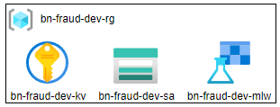
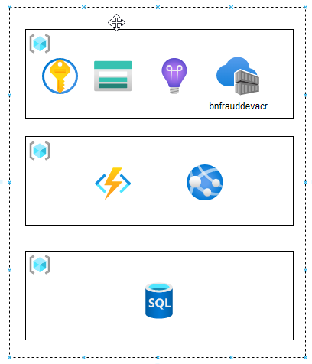
Workload on Azure with single Subscription
Single Subscription
Single Resource Group (simple WL)
Multiple Resource Groups (complex WL)

Slide 20
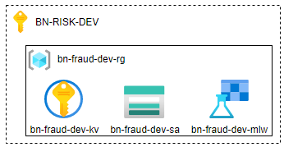
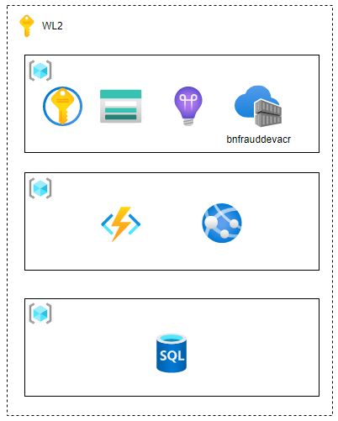
Workload on Azure with Landing Zones
Single Resource Group (simple WL)
Multiple Resource Groups (complex WL)

Slide 21
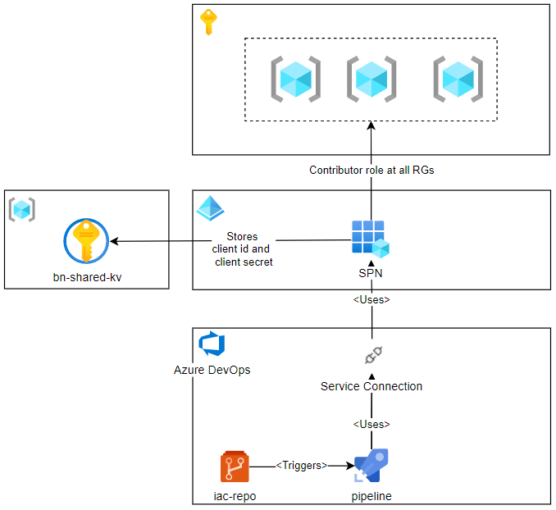
Automation with Azure DevOps
Subscription
One or more RGs
Azure Service Principle (Workload SPN, CI/CD SPN)
Azure DevOps Project
Azure DevOps Service Connection
Azure DevOps IaC Repository
Azure DevOps IaC CI/CD Pipeline

Slide 22
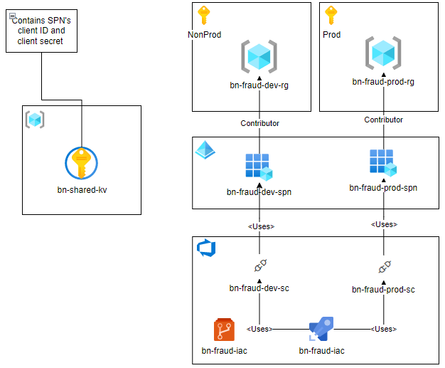
Azure DevOps: multiple environments
One Resource Group
SPN per envirpnment
Azure DevOps resources stored under Risk Project
One Azure DevOps Repo
Branch per environment
Azure DevOps Service Connection per environment
One multi-stage release pipeline

Slide 23
IaC: Azure AD Service Principle
Each WL has dedicated Azure Service Principle (SPN)
SPN permissions scoped to the RG owned by the WL
One WL might be deployed to several Resource Groups
Naming convention:
{prefix}-{workloadName}-{environment}-iac-spn
SPN client id and client secret are stored to the shared KeyVault

Slide 24
Infrastructure as Code (IaC)
IaC from day 1
Minimize click-ops
Team that owns Workload should own WL’ infra code and deployment
Bicep and ARM templates as IaC
Azure DevOps to store code and CICD pipelines
Az PowerShell module or az cli
PowerShell or bash as a scripting language
Same scripts to run under CI/CD and manually
Nightly deployment to overwrite any possible configuration drift

Slide 25
IaC with Azure DevOps
Azure DevOps Project
Azure DevOps Repository to store IaC code
Azure DevOps Pipelines to build / deploy IaC artifacts
Azure DevOps Service Connections to scope access to Azure Resources (Resource Groups, Subscriptions or Management Groups)

Slide 26
IaC: Azure DevOps repository
Azure DevOps Repository
Dedicated repository per Workload
Naming convention:
{prefix}-{workload name}-iac
Branch per environment (dev|test|prod)
All changes are implemented at dev and promoted to other environments/branches (dev->test->prod)
For non Dev branches – use PR

Slide 27
IaC: Azure DevOps pipelines
Use Azure DevOps multi-stage yaml based pipelines
Inherit from master Azure IaC template (checking if it’s possible)
Naming convention:
{prefix}-{workload name}-iac
iac-foobar-iac

Slide 28
IaC: Azure DevOps Service Connection
Dedicated Azure DevOps Service Connection (a.k.a. Service Endpoint) with dedicated SPN
Naming convention:
{prefix}-{workload name}-iac-{environment}-sc

Slide 29
Azure DevOps Automation options
az cli devops extension
Rest API
https://learn.microsoft.com/en-us/rest/api/azure/devops/?view=azure-devops-rest-7.1

Slide 30
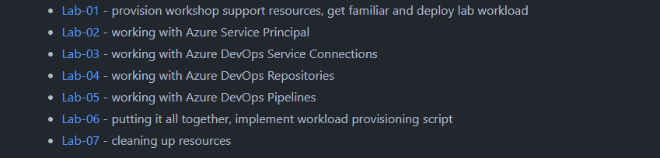
Labs:

Slide 31


